Slide 1
The Link Between Animal Abuse and Family Violence
October 2014

Slide 2
The Link Between Animal Abuse and Family Violence
Faculty:
Michael J. Devereaux Esq.

Slide 3
The Link Between Animal Abuse and Family Violence: Legal and Ethical Issues for Family Court Practitioners
A well-established and growing body of research has demonstrated a connection between animal cruelty and violence against humans, including child abuse and other domestic violence. When animals in a home are abused or neglected, it is a warning sign that others in the household may not be safe. This training will help family court practitioners and other professionals understand and identify animal cruelty in the home as a precursor or indicator of child abuse or neglect or domestic violence.

Slide 4
Understanding the Link Between Animal Cruelty and Interpersonal Violence

Slide 5
Why is this important?
Animal Abuse Exposes Other Criminal Behavior
Link Between Animal Abuse and Family Violence
Role of Pets in American Families
Willingness to Discuss Animal Abuse vs. Child/Domestic Violence

Slide 6
Animal Abuse Exposes Other Criminal Behavior
70% of people charged with cruelty to animals were known by police for other violent behavior--including homicide.
(National Link Coalition—Boat & Knight, 2000)

Slide 7
The Link Between Animal Abuse and Family Violence: Women
Twelve independent surveys have found that between 18% and 48% of battered women have delayed their decision to leave, or have returned to their abusers, out of fear for the welfare of their animals. (Ascione, 2007)

Slide 8
The Link Between Animal Abuse and Family Violence: Women
71% of abused women said their partners harmed, killed or threatened pets. (National Link Coalition—Ascione, Weber & Wood, 1997)

Slide 9
The Link Between Animal Abuse and Family Violence: Children
Abused animals were found in 60% of homes where child abuse or neglect occurred.
Abused animals were found in 88% of homes where physical child abuse occurred.
(DeViney, Dickert, & Lockwood, 1983)

Slide 10
The Link Between Animal Abuse and Family Violence: Children
Children exposed to domestic violence were three times more likely to be cruel to animals. (National Link Coalition—Currie, 2006)
26.8% of boys and 29.4% of girls who were victims of physical and sexual abuse and domestic violence have been reported to abuse the family pet. (Frank R. Ascione, Children and Animals: Exploring the Roots of Kindness and Cruelty (2005))

Slide 11
The Link Between Animal Abuse and Family Violence: Children
75% of the incidents of animal abuse occurred in the presence of children to psychologically control and coerce them.
(National Link Coalition—Ascione, Weber & Wood, 1997)
The parent responsible for abusing the child was often also the person who injured or killed the family pet.
(The First Strike: The Violence Connection. The Humane Society of the United States. DeViney, Dickert & Lockwood, 1983)

Slide 12
The Role of Pets in American Families
64% of households with children under age 6, and 74.8% of households with children over the age of 6, have pets. (Phil Arkow, Latham Foundation)
74% of women entering domestic violence shelters owned pets in the last 12 months. (Ascione, 1998)
~ 1 million animals are abused or killed each year in the U.S. in domestic violence situations (HSUS, 2011)

Slide 13
Willingness to Discuss Animal Abuse vs. Child/Domestic Violence
Victims may be more willing to speak about harm to a pet.
Talking about animal cruelty or neglect may open discussions to other family violence.

Slide 14
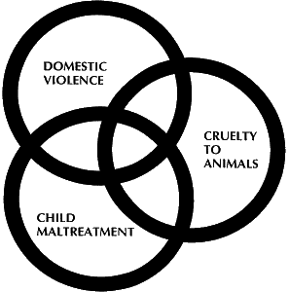
What is “the Link” ?
Correlation between related abuses and violence
Animal abuse
Child abuse
Domestic violence
Elder abuse
Other personal violence
(Ascione, Arkow, 1999)

Slide 15
Historical Recognition of “the Link”
“He who is cruel to animals becomes hard also in his dealings with men. We can judge the heart of a man by his treatment of animals.” Immanuel Kant (1724 –1804), Lectures on Ethics
The Four Stages of Cruelty, William Hogarth, 1751

Slide 16
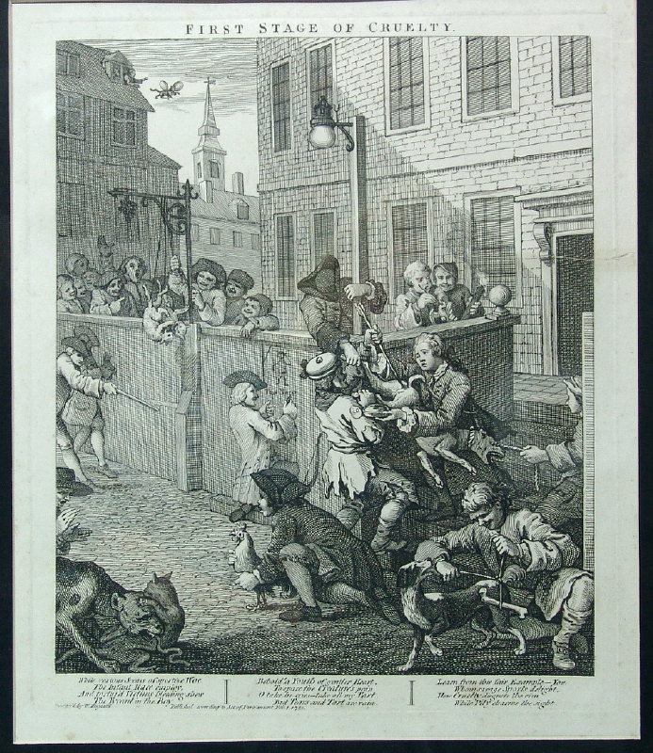

Slide 17
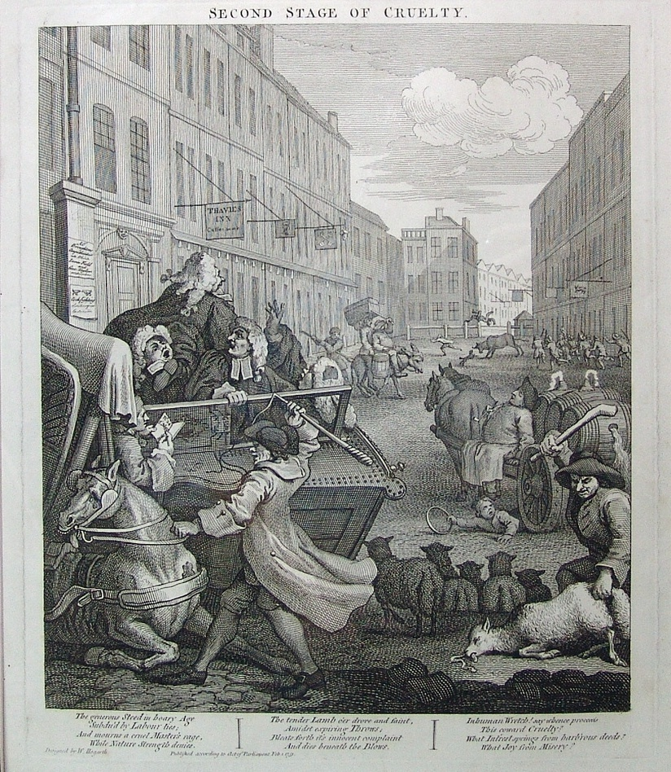

Slide 18
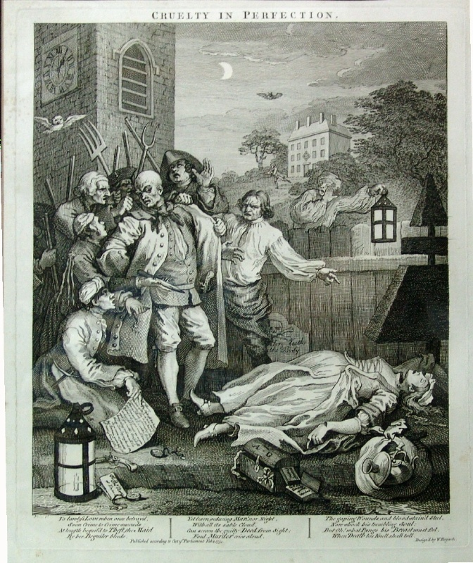

Slide 19
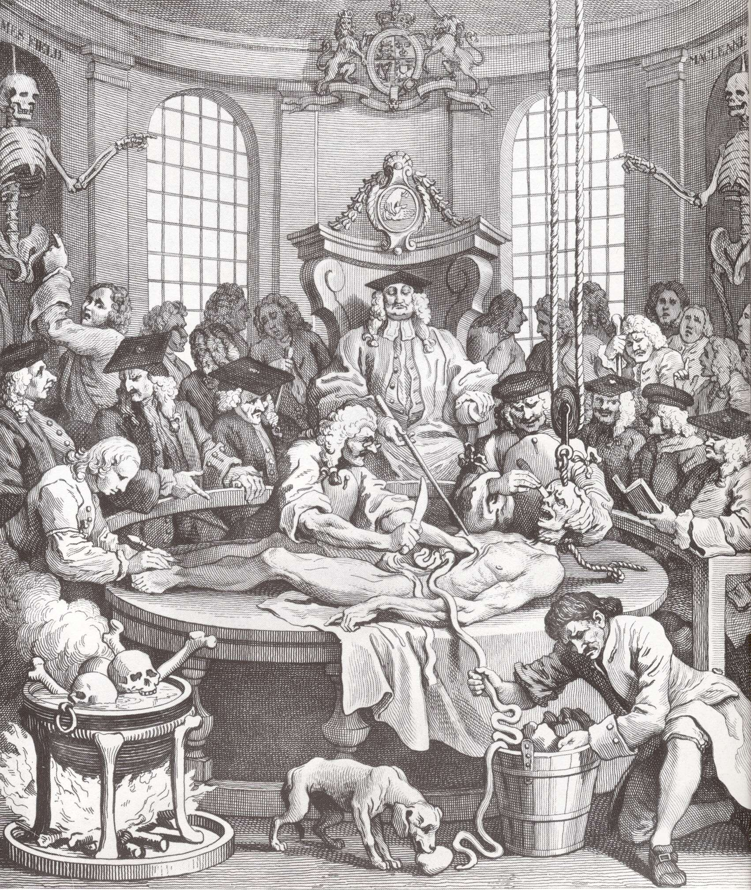

Slide 20
Examples of the Link Between Animal Cruelty and Interpersonal Violence
Animal cruelty: A common trait among serial killers and mass murderers.
Albert DeSalvo (the Boston Strangler)
Tortured and killed dogs and cats
Denis Rader (the BTK killer)
Tortured and killed dogs and cats
Jeffrey Dahmer
Tortured and killed dogs and cats
Columbine school shooters
Tortured and killed dogs and cats

Slide 21
Examples of the Link Between Animal Cruelty and Interpersonal Violence
Animal neglect as a symptom of child neglect or cruelty
June 2013: Two Florida parents were charged with animal abuse and child neglect for keeping two children and 19 neglected, starving dogs and cats in a condemned family home.
2012: Two parents in Pennsylvania were charged with child neglect and animal abuse when police discovered their two young children and pets in a home infested with roaches, covered in feces and urine and one of the children reported that the father had beaten him. Most of the animals were in poor health without food, water or shelter.
2012: Two women in Florida were charged with child abuse and animal cruelty after police found a baby surrounded by animal feces and urine and a starving dog tied up in the yard without food or water.

Slide 22
Examples of the Link Between Animal Cruelty and Interpersonal Violence
Animal neglect as a symptom of child neglect or cruelty
2012: A Florida woman was charged with child neglect and animal cruelty when police responded to a report of animal cruelty, finding two children in “deplorable conditions,” 22 dogs confined without food or water, one with a broken leg, and a dead bird. The women had previously been charged with animal cruelty.
2005: Two parents in Indiana were charged with felony child abuse and animal cruelty, stemming from an investigation into the plight of a dog tied up outside without food and water. Upon entering the home police found a three month old child lying near piles of feces, trash and rotten food.

Slide 23
Examples of the Link Between Animal Cruelty and Interpersonal Violence
Physical animal cruelty as a symptom of child abuse and family violence:
“Look what I can do with your animal, and imagine what I can do to you.”
(Cynthia Hodges, The Link Between Animal Cruelty and Violence Toward People, 2007)

Slide 24
Examples of the Link Between Animal Cruelty and Interpersonal Violence
Animal cruelty as a symptom of child abuse or family violence
2013: Police in Texas responding to a 911 call from a woman who claimed her husband had threatened to kill her led to the husband’s arrest for animal cruelty when detectives found 13 dogs beaten and locked in cages, without food or water, covered in feces, and with cuts and untreated broken bones consistent with dog fighting injuries.
2013: A man in Michigan was charged with animal cruelty for beating his neighbor’s dog to death with a golf club. The man reportedly threatened the woman and her infant son, saying “I killed your dog, what more do I have to do to you guys? Next will be your son.”

Slide 25
Examples of the Link Between Animal Cruelty and Interpersonal Violence
Animal cruelty as a symptom of child abuse or family violence
2013: A man in Texas was charged with felony assault and animal cruelty for assaulting his girlfriend and killing their dogs. A month prior to assaulting his girlfriend, the man killed her 5 lb. poodle by slamming the dog into the wall. One month later, the man beat his girlfriend for several hours and then stabbed the couple’s other dog to death when the dog tried to protect the woman.
2012: A man in Alabama was charged with animal cruelty for killing the family dog by slicing open his dog’s neck in an attempt to intimidate his wife during a custody battle over their children. The man reportedly sent photographs of the dog to his wife with the caption, “your day is coming.”

Slide 26
Examples of the Link Between Animal Cruelty and Interpersonal Violence
Animal cruelty as a symptom of child abuse or family violence
2013: A man in North Carolina was charged with felony assault, child endangerment and animal cruelty after beating the family’s kitten to death and beating and choking his fiancée in front of their 2 year old daughter.
2012: A man in West Virginia was charged with abduction and animal cruelty in connection with the torture and killing of 29 dogs in a domestic violence intimidation scheme. The man reportedly told his girlfriend that the only way she was leaving the house was “in a body bag” and forced her to watch him torture and kill animals, including forcing her to hold a puppy as he killed the dog with an electric drill.
2012: A man in Connecticut was sentenced to prison for animal cruelty and assault after killing his girlfriend’s cat and leaving it at her front door with a note reading “you’re next!”

Slide 27
States With Laws Recognizing the Link Between Animal Cruelty and Interpersonal Violence

Slide 28
Recognition of “The Link” in State Cruelty Laws
All 50 states have animal cruelty statutes
All 50 states have felony penalties for aggravated cruelty
Most of the felony provisions were enacted between 1990 and the early 2000s in response to heightened recognition of the link between animal cruelty and other forms of violence

Slide 29
Recognition of “the Link” in State Cruelty Laws
Dual legislative purposes: Animal welfare and related interpersonal violence
Enactment of NY felony cruelty laws
The NY legislature expressly noted “[t]he connection between animal abusers and violence towards humans” among its legislative findings. N.Y.S. Assembly Memo in Support of L. 1999, ch. 118, 1999 N.Y. Sess. 1584-85
Enactment of CA felony cruelty law
The CA legislature expressly noted an “irrefutable link between domestic violence, child abuse and animal cruelty.” CA Senate Judiciary Committee Analysis of SB 353 regarding felony animal cruelty penalties (enacted as CAL. PENAL CODE § 597(a)), at 4 (Mar. 27, 2007).

Slide 30
Recognition of “the Link” in State Cruelty Laws
First all-encompassing animal cruelty statute in the U.S. enacted in New York in 1867. (N.Y. Rev. Stat. secs. 375.2 - 375.9 (1867).)
a person who "needlessly mutilated, or killed ... any living creature” is guilty of a misdemeanor.
Prior 19th century American state laws covered only commercially valuable animals (horses, livestock) and commonly only applied to 3rd parties (not to the owner of the animal).
NY law drafted by Henry Bergh, founder of ASPCA and the NYSPCC. See David Favre & Vivien Tsang, The Development of Anti-Cruelty Laws During the 1800s, 1993 Det. C.L. Rev. 1 (1993).
Many states enacted cruelty laws in the 19th century following the NY model.

Slide 31
Recognition of “the Link” in State Cruelty Laws
Key purposes of 19th century anti-cruelty laws
to protect personal property
to prevent animal cruelty
to address the link between cruelty to animals and violence to people
Cruelty to animals "injur[es] the moral character of those who witness it --- and may therefore be treated as a crime.” Elbridge T. Gerry, The Law of Cruelty to Animals, Address Before the Bar of Delaware County (August 16, 1875) (quoting LORD CAMPBELL, 9 LIVES LORD CHANCELLORS 22-23). See David Favre & Vivien Tsang, The Development of Anti-Cruelty Laws During the 1800s, 1993 Det. C.L. Rev. 1 (1993).

Slide 32
Recognition of “the Link” in State Laws Permitting Orders of Protection for Pets
Amendment of CA Family Code in 2005 to include orders of protection for pets
The legislature noted the connection “between animal abuse, family violence, and other forms of community violence.” 2007 Cal. Stat. ch. 205, § 1.
Amendment of NY Family Court Act in 2006 to include orders of protection for pets
The NYS legislature expressly noted the connection between animal abuse and domestic violence, including that “often abusers, in an effort to control and threaten their partners, harm or kill their pets.” See Justification memo for Assembly Bill 10767-2006/ Senate Bill No. 7691-2006.

Slide 33
Including Family Pets in an Order of Protection

Slide 34
States with Laws that Include Animals In Orders of Protection
New York
Arizona
Arkansas
California
Colorado
District of Columbia (D.C)
Connecticut
Hawaii
Illinois
Louisiana
Maine
Maryland
Massachusetts
Minnesota
Nevada
New Jersey
North Carolina
Oklahoma
Oregon
Puerto Rico
Tennessee
Texas
Vermont
Washington
West Virginia
Kentucky

Slide 35
New York Law Permits Animals to be Included in Orders of Protection
Order of Protection
Issuable by any NY court to limit the behavior of someone who harms or threatens another, including an animal.
“Any order of protection issued pursuant to this section may require the petitioner or the respondent to refrain from intentionally injuring or killing, without justification, any companion animal the respondent knows to be owned, possessed, leased, kept or held by the petitioner or a minor child residing in the household.” NY FAM CT §842 (i).

Slide 36
California Law Permits Animals to be Included in Orders of Protection
Order of Protection
Issuable by any CA court to limit the behavior of someone who harms or threatens another, including an animal.
“On a showing of good cause, the court may include in a protective order a grant to the petitioner of the exclusive care, possession, or control of any animal owned, possessed, leased, kept, or held by either the petitioner or the respondent or a minor child . . . The court may order the respondent to stay away from the animal and forbid the respondent from taking, transferring, encumbering, concealing, molesting, attacking, striking, threatening, harming, or otherwise disposing of the animal.” CA FAM § 6320 - 6327

Slide 37
Illinois Law Permits Animals to be Included in Orders of Protection
Order of Protection
Issuable by any IL court to limit the behavior of someone who harms or threatens another, including an animal.
The court can “[g]rant the petitioner the exclusive care, custody, or control of any animal owned, possessed, leased, kept, or held by either the petitioner or the respondent or a minor child . . . and order the respondent to stay away from the animal and forbid the respondent from taking, transferring, encumbering, concealing, harming, or otherwise disposing of the animal.” IL ST CH 725 § 5/112A-14
“the court may enter any injunctive orders reasonably necessary to protect animals from any further acts of abuse, neglect, or harassment by a defendant” who has committed acts of cruelty against the animal. 510 ILCS 70/16.3

Slide 38
Recognition of “the Link” in State Laws Re: Cross-Reporting of Abuses
Multi-disciplinary approach to reporting related acts of cruelty: child abuse and animal abuse.
Animal control/humane officers →
report suspected child abuse/neglect
Child protective worker →
report suspected animal abuse/neglect
Mandatory v. Permissive Cross-Reporting
Mandatory: worker must report abuse
Permissive: worker may report suspected abuse but not required
Hybrid: mandatory reporting of child abuse but only permissive reporting of animal abuse

Slide 39
States with Laws re: Cross-Reporting of Animal Abuse and Child Abuse (mandatory or permissive)
California
Colorado
Connecticut
District of Columbia
Illinois
Kentucky
Louisiana
Maine
Massachusetts
Nebraska
Ohio
Oregon
Tennessee
Virginia
West Virginia

Slide 40
States with Laws re: Cross-Reporting of Animal Abuse and Child Abuse
California
Mandatory reporting of child abuse by animal workers
Veterinarians (Cal. P.C. 11165.7(21)) and humane officers and animal control officers (Cal. P.C. 11165.7(31)) are mandatory reporters of child neglect/abuse
Permissive reporting of animal abuse by child workers
“Any employee of a county child or adult protective services agency, while acting in his or her professional capacity or within the scope of his or her employment, who has knowledge of or observes an animal whom he or she knows or reasonably suspects has been the victim of cruelty, abuse, or neglect, may report the known or reasonably suspected animal cruelty, abuse, or neglect to the entity or entities that investigate reports of animal cruelty, abuse, and neglect in that county.” Cal. P.C. Section 11199

Slide 41
States with Laws re: Cross-Reporting of Animal Abuse and Child Abuse
Illinois
Mandatory reporting of child abuse by animal workers
Humane officers/investigator and animal control officers (325 ILCS 5/4, Sec. 4) are mandatory reporters of child neglect/abuse
Mandatory reporting of animal abuse by child service workers
“[specialists of ] the Department of Children and Family Services who reasonably believe that an animal observed by them when in their professional or official capacity is being abused or neglected in violation of this Act must immediately make a written or oral report to the Department of Agriculture's Bureau of Animal Health and Welfare.” Illinois 325 ILCS 5/11.8, Sec. 11.8.

Slide 42
States with Laws re: Cross-Reporting of Animal Abuse and Child Abuse
New York
Mandatory reporting of child abuse by animal workers
Humane officers are peace officers under NYS law (N.Y. CPL §2.10(7)) and are therefore mandatory reporters of child neglect/abuse (N.Y. SOS. LAW § 413).
There is no animal cruelty reporting requirement for child service workers

Slide 43
States with Laws re: Cross-Reporting of Animal Abuse and Child Abuse
Virginia
Mandatory reporting of child abuse by animal workers
Humane officers are mandated reporters of child neglect/abuse in VA (Code of Virginia § 63.2-1509)
There is no animal cruelty reporting requirement for child service workers

Slide 44
Defining and Identifying and Reporting Animal Cruelty, Abuse and Neglect Under State Law

Slide 45
ANIMAL CRUELTY STATUTES
ALL 50 STATES and the D.C. and the U.S. Territories, including Puerto Rico have animal cruelty statutes
Partnership of ASPCA and Michigan State University College of Law created easily accessible compendium of all 50 States and D.C.
www.animallaw.info

Slide 46
Overview of State Animal Cruelty Laws
Every state’s animal cruelty laws address:
Animal neglect and abandonment
Generally misdemeanor, multiple incidents may constitute felony
Omissions: lack of food, water, shelter, appropriate living conditions
Animal abuse
Physical acts of cruelty or intentional omissions
Misdemeanor
Generally applicable to all animals
Felony
Aggravated cruelty, multiple incidents
Specific type of animal involved (dog/cat)
Note: some states include all animals in felony cruelty law
Animal fighting
Fighting activities (fighting, training) are a felony in all 50 states
Associated activities (spectators, betting, etc.) vary by state (some misdemeanor, some felony)

Slide 47
ANIMAL CRUELTY STATUTES OVERVIEW
the statutory framework is animal welfareism (balancing interests against rights)
transformational paradigm implementing the predictive link known for centuries possibly part of an even greater transformational shift based on science establishing sentient being of animals and thus animal rights

Slide 48
FOCUS IS ON STATES, NOT FEDERAL WHY?
“AWA” ANIMAL WELFARE ACT, passed in 1966
limited to regulating treatment of animals in research and exhibition
“APHIS” ANIMAL AND PLANT HEALTH INSPECTION SERVICES: is the enforcement arm
TRANSFORMATIONAL PARADIGM IMPLEMENTING THE LINK KNOWN FOR CENTURIES IS OCCURRING ON STATE, NOT NATIONAL LEVEL

Slide 49
ANIMAL CRUELTY STATUTES VARY SIGNIFICANTLY
Exemptions : vary widely from state to state
: can eviscerate an otherwise strong anti-cruelty law
: exemptions for veterinarians, research, wildlife, farming, food,
pest-control(culling), rodeos, zoos, circuses, killing on one’s own property
: some states have no exemptions
cross-reporting, veterinarian reporting, arrest policies, re: seizure, forfeiture, reimbursement, etc., varies from state-to-state
what constitutes misdemeanor or felony varies from state-to-state
Penalties for misdemeanors or felonies varies from state-to-state
for example, in Mississippi, penalties for neglect and dog-fighting are the same: up to $100 or up to 100 days in jail
for example, in Mississippi, the malicious killing of pet is up to $1,000 or no more than 6 months in jail
CONCLUSION: statutory language varies significantly requiring each state’s law’s to be diligently
scrutinized

Slide 50
NEW YORK ANIMAL CRUELTY STATUTE Citation: McKinney's Ag. and Mkts Law § 331-379; McKinney's Penal Law § 130.20; NY AG. & MKTS §§ 331 - 379; NY PENAL LAW § 130.20
Summary: Sections 353 and 353-a are NY’s anti-cruelty provisions. "Animal" includes every living creature except a human being.
§ 353. Overdriving, torturing and injuring animals; failure to provide proper sustenance
A person who overdrives, overloads, tortures or cruelly beats or unjustifiably injures, maims, mutilates or kills any animal, whether wild or tame, and whether belonging to himself or to another, or deprives any animal of necessary sustenance, food or drink, or neglects or refuses to furnish it such sustenance or drink, or causes, procures or permits any animal to be overdriven, overloaded, tortured, cruelly beaten, or unjustifiably injured, maimed, mutilated or killed, or to be deprived of necessary food or drink, or who willfully sets on foot, instigates, engages in, or in any way furthers any act of cruelty to any animal, or any act tending to produce such cruelty, is guilty of a class A misdemeanor…
Nothing herein contained shall be construed to prohibit or interfere with any properly conducted scientific tests, experiments or investigations, involving the use of living animals, performed or conducted in laboratories or institutions…

Slide 51
NEW YORK ANIMAL CRUELTY STATUTE (cont.) Citation: McKinney's Ag. and Mkts Law § 331-379; McKinney's Penal Law § 130.20; NY AG. & MKTS §§ 331 - 379; NY PENAL LAW § 130.20
§ 353-a. Aggravated cruelty to animals
A person is guilty of aggravated cruelty to animals when, with no justifiable purpose, he or she intentionally kills or intentionally causes serious physical injury to a companion animal with aggravated cruelty. For purposes of this section, "aggravated cruelty" shall mean conduct which: (i) is intended to cause extreme physical pain; or (ii) is done or carried out in an especially depraved or sadistic manner.
Nothing contained in this section shall be construed to prohibit or interfere in any way with anyone lawfully engaged in hunting, trapping, or fishing, as provided in article eleven of the environmental conservation law, the dispatch of rabid or diseased animals, as provided in article twenty-one of the public health law, or the dispatch of animals posing a threat to human safety or other animals, where such action is otherwise legally authorized, or any properly conducted scientific tests, experiments, or investigations involving the use of living animals, performed or conducted in laboratories or institutions…
Aggravated cruelty to animals is a felony. A defendant convicted of this offense shall be sentenced…to term of imprisonment…which may not exceed two years.

Slide 52
People v. Garcia 3 Misc3d 699, 777 NYS2d 846 [Supreme Court, New York County 2004], aff’d as modified, 29 AD3d 255, 812 NYS2d 66 [1st Dept 2006], leave to appeal denied by, 7 NYS3d 789, 821 NYS2d 818 [2006]; writ of habeas petition denied, Garcia v. Rivera, Not Reported In F Supp2d, 2007 WL 2325928 [SDNY 2007]
“Pet goldfish were “companion animals” within the meaning of statute prohibiting aggravated cruelty to animals, and therefore defendant who stomped on a boy’s pet goldfish was guilty of violating that statute; goldfish were domesticated inasmuch as they had been adapted to live in close association with humans, and they were being kept as part of boy’s household. McKinney’s Agriculture and Markets Law §§ 350(5), 353-a(1).”

Slide 53
CALIFORNIA ANIMAL CRUELTY STATUTE California Penal Code Sections Citation: Cal. Penal Code §§ 286.5; 596 - 600.5; CA PENAL §§ 286.5; 596 - 600.5
Summary: California’s anti-cruelty statute is Section 597 of the Penal Code.
Section 597:
…every person who maliciously and intentionally maims, mutilates, tortures, or wounds a living animal, or maliciously and intentionally kills an animal, is guilty of a crime…
Except as otherwise provided in subdivision (a) or (c), every person who overdrives, overloads, drives when overloaded, overworks, tortures, torments, deprives of necessary sustenance, drink, or shelter, cruelly beats, mutilates, or cruelly kills any animal, or causes or procures any animal to be so overdriven, overloaded, driven when overloaded, overworked, tortured, tormented, deprived of necessary sustenance, drink, shelter, or to be cruelly beaten, mutilated, or cruelly killed; and whoever, having the charge or custody of any animal, either as owner or otherwise, subjects any animal to needless suffering, or inflicts unnecessary cruelty upon the animal, or in any manner abuses any animal, or fails to provide the animal with proper food, drink, or shelter or protection from the weather, or who drives, rides, or otherwise uses the animal when unfit for labor, is, for each offense, guilty of a crime…
Every person who maliciously and intentionally maims, mutilates, or tortures any mammal, bird, reptile, amphibian, or fish, as described in subdivision (e), is guilty of a crime.....

Slide 54
ILLINOIS ANIMAL CRUELTY STATUTE Illinois Compiled Statutes Annotated. Chapter 510. Animals. Act 70. Humane Care for Animals Act.
Summary: The Humane Care of Animals Act is a comprehensive statute providing the State's anti-cruelty provisions. "Animal" means every living creature, domestic or wild, but does not include man. An individual is guilty of a Class B misdemeanor for the first offense and a second or subsequent violation is a Class 4 felony with every day that a violation continues constituting a separate offense. The cruelty provisions are listed at 510 ILCS 70/3.01, 3.02, and 3.03. The owner's duty provisions (510 ILCS 70/3) spell out what care an owner must provide and the legal consequences of neglect.
510 ILCS 70/3.01: Cruel treatment. No person or owner may beat, cruelly treat, torment, starve, overwork or otherwise abuse any animal. No owner may abandon any animal where it may become a public charge or may suffer injury, hunger or exposure.
510 ILCS 70/3.02: Aggravated cruelty.
No person may intentionally commit an act that causes a companion animal to suffer serious injury or death.

Slide 55
ILLINOIS CRUELTY STATUTE (cont.) Illinois Compiled Statutes Annotated. Chapter 510. Animals. Act 70. Humane Care for Animals Act.
510 ILCS 70/3.03: Animal torture.
A person commits animal torture when that person without legal justification knowingly or intentionally tortures an animal. For purposes of this Section, and subject to subsection (b), "torture" means infliction of or subjection to extreme physical pain, motivated by an intent to increase or prolong the pain, suffering, or agony of the animal.
For the purposes of this Section, "animal torture" does not include any death, harm, or injury caused to any animal by any of the following activities:
any hunting, fishing, trapping, or other activity allowed under the Wildlife Code, the Wildlife Habitat Management Areas Act, or the Fish and Aquatic Life Code;
any alteration or destruction of any animal done by any person or unit of government pursuant to statute, ordinance, court order, or the direction of a licensed veterinarian;
any alteration or destruction of any animal by any person for any legitimate purpose, including, but not limited to: castration, culling, declawing, defanging, ear cropping, euthanasia, gelding, grooming, neutering, polling, shearing, shoeing, slaughtering, spaying, tail docking, and vivisection; and
any other activity that may be lawfully done to an animal.

Slide 56
VIRGINIA ANIMAL CRUELTY STATUTE Va. Code Ann. §§ 3.2-6500 - 6590; Va. Code Ann. § 18.2-361; Citation: VA ST § 3.2-6500 - 6590; VA ST § 18.2-361
Summary: Virginia's statutes set forth in Title 3.2, the Comprehensive Animal Care laws, provides Virginia's anti-cruelty provisions. For the purposes of § 3.2-6570, the operative animal cruelty law, animal means any nonhuman vertebrate species including fish except those fish captured and killed or disposed of in a reasonable and customary manner. Violations are punishable as a Class 1 misdemeanor but also has a felony component, where torture occurs, certain misdemeanor acts are done "willfully," or a person maliciously deprives any companion animal of necessary food, drink, shelter or emergency veterinary treatment.
Article 9. Cruelty to Animals § 3.2-6570. Cruelty to animals; penalty
Any person who: (i) overrides, overdrives, overloads, tortures, ill-treats, abandons, willfully inflicts inhumane injury or pain not connected with bona fide scientific or medical experimentation, or cruelly or unnecessarily beats, maims, mutilates, or kills any animal, whether belonging to himself or another; (ii) deprives any animal of necessary food, drink, shelter or emergency veterinary treatment; (iii) sores any equine for any purpose or administers drugs or medications to alter or mask such soring for the purpose of sale, show, or exhibition of any kind, unless such administration of drugs or medications is within the context of a veterinary client-patient relationship and solely for therapeutic purposes; (iv) willfully sets on foot, instigates, engages in, or in any way furthers any act of cruelty to any animal; (v) carries or causes to be carried by any vehicle, vessel or otherwise any animal in a cruel, brutal, or inhumane manner, so as to produce torture or unnecessary suffering; or (vi) causes any of the above things, or being the owner of such animal permits such acts to be done...
Any person who: (i) tortures, willfully inflicts [see above]…is guilty of a Class 6 felony…
Nothing in this section shall be construed to prohibit the dehorning of cattle conducted in a reasonable and customary manner.

Slide 57
VIRGINIA ANIMAL CRUELTY STATUTE (cont.) Va. Code Ann. §§ 3.2-6500 - 6590; Va. Code Ann. § 18.2-361; Citation: VA ST § 3.2-6500 - 6590; VA ST § 18.2-361
This section shall not prohibit authorized wildlife management activities or hunting, fishing or trapping …to farming activities as provided under this title or regulations adopted hereunder.
It is unlawful for any person to kill a domestic dog or cat for the purpose of obtaining the hide, fur or pelt of the dog or cat…
Any person who: (i) tortures, willfully inflicts inhumane injury or pain not connected with bona fide scientific or medical experimentation or cruelly and unnecessarily beats, maims or mutilates any dog or cat that is a companion animal whether belonging to him or another; and (ii) as a direct result causes the death of such dog or cat that is a companion animal…is guilty of a Class 6 felony. If a dog or cat is attacked on its owner's property by a dog so as to cause injury or death, the owner of the injured dog or cat may use all reasonable and necessary force against the dog at the time of the attack to protect his dog or cat. Such owner may be presumed to have taken necessary and appropriate action to defend his dog or cat and shall therefore be presumed not to have violated this subsection.

Slide 58
RHODE ISLAND ANIMAL CRUELTY, ANIMAL FIGHTING AND ANIMAL ADVOCATES
4-1-2. Overwork, mistreatment, or failure to feed animals--Shelter defined
(a) Whoever overdrives, overloads, drives when overloaded, overworks, tortures, torments, deprives of necessary sustenance, cruelly beats, mutilates or cruelly kills, or causes or procures to be so overdriven, overloaded, driven when overloaded, overworked, tortured, tormented, deprived of necessary sustenance, cruelly beaten, mutilated or cruelly killed, any animal, and whoever, having the charge or custody of any animal, either as owner or otherwise, inflicts cruelty upon that animal, or willfully fails to provide that animal with proper food, drink, shelter or protection from the weather...
§ 4-1-3. Unnecessary cruelty
(a) Every owner, possessor, or person having the charge or custody of any animal, who cruelly drives or works that animal when unfit for labor, or cruelly abandons that animal, or who carries that animal or who fails to provide that animal with adequate living conditions ...or causes that animal to be carried, in or upon any vehicle or otherwise in a cruel or inhuman manner, or willfully, intentionally, maliciously, recklessly, and/or knowingly authorizes or permits that animal to be subjected to unnecessary torture, suffering or cruelty of any kind, or who places or causes to have placed on any animal any substance that may produce irritation or pain, or that is declared a hazardous substance by the U.S. food and drug administration or by the state department of health...
§ 4-1-4. Abandonment of infirm animals
If any maimed, sick, infirm, or disabled animal is abandoned to die, by any owner or person having charge of that animal...
§ 4-1-5. Malicious injury to or killing of animals
(a) Every person who cuts out the tongue or otherwise dismembers any animal, maliciously, or maliciously kills or wounds any animal, or maliciously administers poison to or exposes any poisonous substance with intent that the poison shall be taken or swallowed by any animal, or who maliciously exposes poisoned meat with intent that the poisoned meat is taken or swallowed by any wild animal...
…

Slide 59
RHODE ISLAND ANIMAL CRUELTY, ANIMAL FIGHTING AND ANIMAL ADVOCATES (cont.)
4-1-9. Animal fighting. –
Any person who causes or encourages the fighting of any bird, dog, or animal with any other bird, dog, or animal, or keeps or maintains any place for the fighting of birds, dogs, or animals, or who knowingly permits, or suffers, any fight to be had on his or her premises or on premises under his or her control, or makes any bet or lays any wager of any kind upon the result of that fight...
4-1-10. Possession or training of fighting animals. –
Whoever owns, possesses, keeps or trains any bird, dog, or other animal, with the intent that that bird, dog, or animal engages in an exhibition of fighting...
4-1-11. Attendance at bird or animal fight. –
Whoever is present at any place, building, or tenement where preparations are being made for an exhibition of the fighting of birds or animals, with the intent being present at that exhibition, or is present at that exhibition...
…
4-1-31. Assignment of state veterinarian. –
(c) The director of the department of environmental management may designate a department veterinarian or veterinarians to act as animal advocates. A general agent or special agent from the Rhode Island society for the prevention of cruelty to animals may also act in that capacity.
(d) The animal advocate shall make recommendations to any court before which the custody or well-being of an animal is at issue.

Slide 60
ANIMAL FIGHTING All 50 States have Anti-Dog Fighting Statutes
Violations of dog-fighting laws are felonies carrying much stiffer penalties than anti-cruelty laws. Animal-Fighting laws exist independently of anti-cruelty laws. Violators of animal-fighting laws can be charged and convicted under both sets of laws. Generally, it is not only illegal to engage in dog fighting, but also to possess or train dogs for fighting. Additionally, in most states it is illegal to even attend a dog fight. Animal-fighting laws require knowledge, or mens rea, such that the individual must intentionally engage in wrongful conduct…
New York Ag. & Mkts. § 351. Prohibition of animal fighting
…“animal fighting” shall mean any fight between cocks or other birds, or between dogs, bulls, bears or any other animals, or between any such animal and a person or persons, except in exhibitions of a kind commonly featured at rodeos.
Any person who engages in any of the following conduct is guilty of a felony punishable by imprisonment for a period not to exceed four years, or by a fine not to exceed twenty-five thousand dollars, or by both such fine and imprisonment:
For amusement or gain, causes any animal to engage in animal fighting; or b) Trains any animal under circumstances evincing an intent that such animal engage in animal fighting for amusement or gain; or c) Breeds, sells or offers for sale any animal under circumstances evincing an intent that such animal engage in animal fighting; or…e) Owns, possesses or keeps any [such] animal…

Slide 61
ANIMAL FIGHTING (cont.) All 50 States have Anti-Dog Fighting Statutes
a) Any person who engages in conduct specified in paragraph (b) of this subdivision is guilty of a misdemeanor…b) The owning, possessing or keeping of any animal under circumstances evincing an intent that such animal engage in animal fighting.
a) Any person who engages in conduct specified in paragraph (b) hereof is guilty of a misdemeanor …b) The knowing presence as a spectator…
a) Any person who intentionally owns, possesses, sells, transfers or manufactures animal fighting paraphernalia with the intent to engage in or otherwise promote or facilitate animal fighting…

Slide 62
ENFORCEMENT
Statutory framework is only part of the story
www.humanesociety.org: ranks all 50 states and D.C. in terms of its effectiveness, enforcement
California is #1
Oregon, Illinois, Massachusetts, New York, Maine, Colorado and Virginia in top ten
Idaho, Missouri, South Dakota, Mississippi, Utah among the very worst

Slide 63
Enforcement in each state is a complex, oftentimes confusing amalgam
Police:
Local Police: City, town and village and even hamlet police
State Police: www.troopers.ny.gov
Federal Police: National Park Service Rangers
Agencies:
Animal Control
Not-For-Profits:
National, state and local entities
Reality Check: Each state’s enforcement is a unique state-centric
combination of a hodge-podge complexity

Slide 64
Enforcement of Anti-Dog/Animal Fighting Laws Requires Trained and Properly Equipped Personnel
Animal control, not-for-profit humane organizations are not specially trained nor equipped to enforce anti-dog/animal fighting laws because of the heightened and dangerous level of organized criminality involving engrained violence and blood-sports.
Specially trained, seasoned, equipped and properly funded law enforcement is needed, along with dedicated and experienced prosecutors.

Slide 65
REPORTER PROPERLY REPORTING CRUELTY IS CRUCIAL
Non-uniform, state-centric combination of hodge-podge complexity has a very plain or obvious problem: reporting
Reporting is extremely crucial because of the non-uniform enforcement where
courts are under-funded
prosecutors are over-worked, and not specially trained
agencies are under-budgeted
not-for-profits are not typically 24/7
Reporting animal cruelty not typically as simple as dialing a telephone number
Reporting animal cruelty requires more than one call, providing evidentiary detail, follow-up and persistence

Slide 66
HOW TO REPORT
Police | : | www.usacops.com
ASPCA | : | the first humane organization in North America created by a special act of NY legislature has an enforcement arm called Humane Law Enforcement (“HLE”), which handled over 17,000 calls last year
The Humane Society of US | : | nation’s largest animal protection organization www.humanesociety.org
Animal Legal Defense Fund | : | founded in 1979 by attorneys Website is www.aldf.org divide reporting into categories: pet store, rodeos, hoarding, etc.
COMMON DENOMINATOR: | : | all require being proactive, follow-up, diligence with documentary evidence

Slide 67
REPORTING SUSPECTED ANIMAL CRUELTY OR NEGLECT IN NEW YORK STATE
in NYC: For animal crimes in progress and other animal emergencies in NYC, DIAL 911; For ongoing animal cruelty or neglect in NYC, dial 311; You may also file a report online at http://bit.ly/Humane311
in NY State Counties (Outside of NYC): For animal crimes in progress and other animal emergencies anywhere in NY State, DIAL 911; For ongoing animal cruelty or neglect, call your county’s (1) local police; and (2) local SPCA/animal control (where available).
CONTACT INFORMATION FOR LOCAL POLICE AND SPCAS THROUGHOUT NEW YORK STATE (BY COUNTY):
See attached hand-out

Slide 68
Common Indicators of Neglect
Poor body condition
Severe fur matting and/or filthy coat
Congested eyes or ears
Flea/tick infestation
Underweight with visible bones
Limping or inability to stand or walk normally
Animal in obvious physical distress, in need of veterinary care
Lack of Food or Water
The animal has no obvious sources of food/water
Underweight with visible bones
The animal may exhibit extreme behavior (aggression or lethargy) due to starvation/thirst
Lack of Sanitation
Feces/debris covers the animal’s living area
More animals at a property than can be properly cared for
Lack of Adequate Shelter
Animal is contained in an area fully exposed to inclement weather or constant sun
Abandonment
Animal is left in a house or yard that appears empty
A dog howling or barking for several hours may be a sign of abandonment

Slide 69
Common Indicators of Abuse and Cruelty
Signs of Physical Abuse
Open wounds
Scars
Missing fur
Missing limbs or body parts
Burn marks
Aggression or fear (e.g., cowering, hiding, fear-biting)
Animal is improperly caged or restrained
has little room to move, and/or is unable to stand or turn
restrained by a chain, rope or other device for extended periods of time
Chains, or ropes around or embedded into the animal’s neck
Evidence of Dog Fighting
Training implements
ex. treadmills, spring poles, restraining devices)
Obvious signs of trauma
scars, open wounds, infections, missing body parts
Fighting paraphernalia
Fighting ring
Blood stains
Dog fighting publications

Slide 70
Assessment of Animal Cruelty in Evaluating Child Abuse and Domestic Violence Situations

Slide 71
Observations to Make and Why
Are there visible signs of animal abuse or neglect in the home?
Is there a dead animal in or around the home?
Is there an injured animal in or around the home?
Ex. Cuts, open wounds, bruises, broken bones, limp/inability to walk or get up, burns, missing fur, collar embedded in animal’s neck?
Do animals appear to have adequate food and water?
Does the animal look extremely thin/underweight with ribs protruding?
Is there evidence of food and water?
Do animals have appropriate shelter and sanitary conditions?
Exposure to extreme weather (heat, cold, rain, etc.)?
Clean living areas?
Infestation with parasites, Fur matted and dirty?

Slide 72
Observations to Make and Why
Are there visible signs of animal abuse or neglect in the home?
Have you witnessed abusive behavior toward the animal?
Hitting, kicking, pushing the animal?
Yelling at the animal or threatening physical harm?
Does the animal cower or behave aggressively toward anyone in the home?

Slide 73
Questions to Ask About Animal Neglect
Have you or your family ever had a pet?
Who feeds and cares for the pet? Where does the pet live?
Has a pet ever been sick/injured? Lost or given away? Has a pet died?
Has the animal ever bit or harmed anyone in the home?
Such inquires provide useful information about family function and identifying patterns of neglect and others who may be at risk

Slide 74
Questions to Ask About Animal Abuse
Have you or your family ever had a pet?
Has a pet ever been hurt? Has a pet died? Taken away/given away?
Has anyone ever threatened to hurt the pet?
If the animal does something wrong, what happens?
Do you worry about something bad happening to your pet?
Have you ever heard about or seen someone hurt an animal (in the home/outside the home)?
*Such inquires provide useful information about family functioning and identify patterns of violence and others who may be at risk.

Slide 75
Resources and Actions to be Taken in Family Violence Situations With Animals
Orders of protection for family pets.
Using evidence of animal abuse as basis for child abuse/neglect petition or domestic violence injunction.
Sheltering programs for people and pets.
Counseling and rehabilitation (for victims and abusers).
Recovery for damages associated with pet abuse.

Slide 76
Utilizing Evidence of Animal Cruelty as a Basis for Child Neglect
Animal cruelty or neglect may be the basis of a child neglect or abuse petition.

Slide 77
Child Neglect Petitions Based on Animal Cruelty or Neglect
Definitions of Child Neglect Include Psychological Harm
and Risk of Physical Harm
NY law defines Child Neglect to include impairment or risk of impairment of “physical, mental or emotional condition” due to parent’s failure to exercise a minimum degree of care by inflicting harm or a substantial risk of harm by “any other acts of a similarly serious nature requiring the aid of the court.” See FCA §1012(f)(i)(B).
Exposure of Children to Domestic Violence Constitutes Child Neglect
Courts interpret this “catch all” phrase to mean that exposing children to domestic violence is a basis for child neglect. See, e.g., Nicholson v. Scoppetta, 3 N.Y.3d 357, 371 (2004).
Rationale: Exposure of children to such violence creates emotional harm and may also signify a potential risk of physical injury to the children themselves.

Slide 78
Child Neglect/Abuse Petitions Based on Animal Cruelty or Neglect
Exposing Children to Animal Abuse May Constitute Child Neglect
Witnessing animal cruelty has similar emotional impact and present the same risk of physical harm as domestic violence
Emotional harm from witnessing violence against a family pet
Abuser may harm animals as a means of terrorizing children or partners
See In the matter of Evelyn “X”, 290 A.D.2d 817, 821 (3rd Dep’t 2002) (Child neglect found where parent purposefully let child’s dog run in the street (and be hit and killed in traffic) as punishment for not getting up on time for school and then “taunted the child with a mocking comment about the dead animal,” telling the child “that it was his fault the dog died because he did not get up when told.”).
Risk of physical injury to children
Parent violent with animals may be violent with children
Abused animals more aggressive

Slide 79
Child Neglect/Abuse Petitions Based on Animal Cruelty or Neglect
Exposing Children to Animal Neglect May Be Basis for Child Neglect or Abuse Petitions
Exposure of children to the filth and squalor of neglected pets may also present a health hazard to children rising to the level of neglect or abuse.
See In the matter of Edward A. Carpenter, 94 A.D.3d 1367, 1367 (3rd Dep’t 2012) (affirming finding of child neglect where children kept in a home “littered with garbage, feces and the remnants of a cat’s afterbirth”).

Slide 80
Using Evidence of Animal Cruelty as a Factor in Custodial Decisions
Evidence of a parent’s acts of violence or threatened violence against animals may be considered a factor in custody determinations.
Many states require consideration of any “each parent and adult household member's present and past violent or abusive conduct” in custodial decisions.
See, e.g., 23 Pa. Cons. Stat. § 5303

Slide 81
Utilizing Evidence of Animal Cruelty as a Basis for Domestic Violence Injunction
Animal cruelty may be the basis of a domestic violence injunction.

Slide 82
Domestic Violence Injunctions Based on Animal Cruelty
Injuring or killing an animal with the intent to threaten a family member may be considered an act of domestic violence. See, e.g., Ind. Code Ann. § 31-9-2-42 (4).
Court may consider abuse or killing of a pet as a factor for a domestic violence injunction. See, e.g., Fla. Stat. § 741.30(3)(b).
Violence or threats of violence against a pet may be considered a factor in determining if petitioner is in imminent danger of becoming a victim of domestic violence. See, e.g., Fla. Stat. § 741.30(6)(b)(4).
Killing or threatening to kill a pet constitutes abuse that can constitute grounds for granting a temporary order that requires the defendant to relinquish all firearms to the sheriff as part of a domestic violence protection order. See 23 Pa.C.S. § 6107 (b)(3)(ii)(E)(II)).

Slide 83
Recovery for Damages by Family Violence Victims Whose Pets Are Harmed by Abusers
A person whose pet is subjected to animal cruelty may have a right of action against abusers for damages associated with the abuse or death of an animal (including veterinary expenses, emotional distress, and punitive damages) via specific statutes or restitution
Alabama law allows recovery of up to $1,000 (Alabama Code § 3110)
Illinois law allows up to $25,000 in damages (510 ILCS 70/16.3)
Most states require restitution to victims of crimes
E.g., California law mandates restitution for conviction in all crimes, including animal cruelty (Cal. Penal Code section 1202.4(b))
Attorney Ethics
Competence: does your state allow for damages recovery for animal abuse/neglect?
Zealous representation
Seeking enforcement of animal crimes occurring in family violence situation increases protection for your client

Slide 84
Counseling and Rehabilitative Resources for Offenders
Psychological counseling (cruelty/abuse)
Mandatory psychological counseling for violations of animal cruelty laws
California (CA Penal Code Section 597(g)) (animal cruelty)
Illinois (for felony cruelty: 510 ILL. COMP. STAT. 70/3.03(c))
Courts may order psychological counseling for animal cruelty
Illinois (for non-felony cruelty: 510 ILL. COMP. STAT. 70/3.02(c))
New York (N.Y. PEN. LAW § 65.10(2); see also People v. Letterlough, 86 NY2d 259 (1995))
Virginia (VA. CODE ANN § 3.2-6570(A))
Animal care and husbandry training (neglect)

Slide 85
Counseling and Rehabilitative Resources for Family Abuse Victims With Pets
Psychological counseling and therapy for victims
Particularly important for children exposed to animal abuse due to risk of behavioral issues:
Imitation of abusive behaviors – with animals and people
Ex. Children who witness animal abuse in the home are at greater risk for becoming victims or perpetrators of abuse (Osofsky, 1995).
Ex. Children exposed to domestic violence are three times more likely to be cruel to animals than children not exposed to domestic violence (Currie, 2006).
Desensitization to violence; acceptance of violence as part of family dynamic
Damaged sense of safety and confidence in adults
(Lockwood 2007, Ascione et al., 2007; Baldry, 2003)

Slide 86
Sheltering Resources for Victims of Family Violence with Pets
Pet-friendly domestic violence shelters
E.g. NYC’s Urban Resource Institute has a pet-friendly domestic violence shelter
Dedicated sheltering programs for pets of families escaping domestic violence to shelters where pets are not permitted
Searchable national database of resources for family violence victims with pets
National Animal Welfare Institute’s Safe Havens Mapping Project: http://www.awionline.org/safe-havens

